Slide 1





Don’t Be A Thief From The Reef:
The Effect of Climate Change
on The Great Barrier Reef

Slide 2





TEAM MEMBERS
Aastha
Alan
ARORA
FRANZEN
Dianne
JARDINEZ

Slide 3

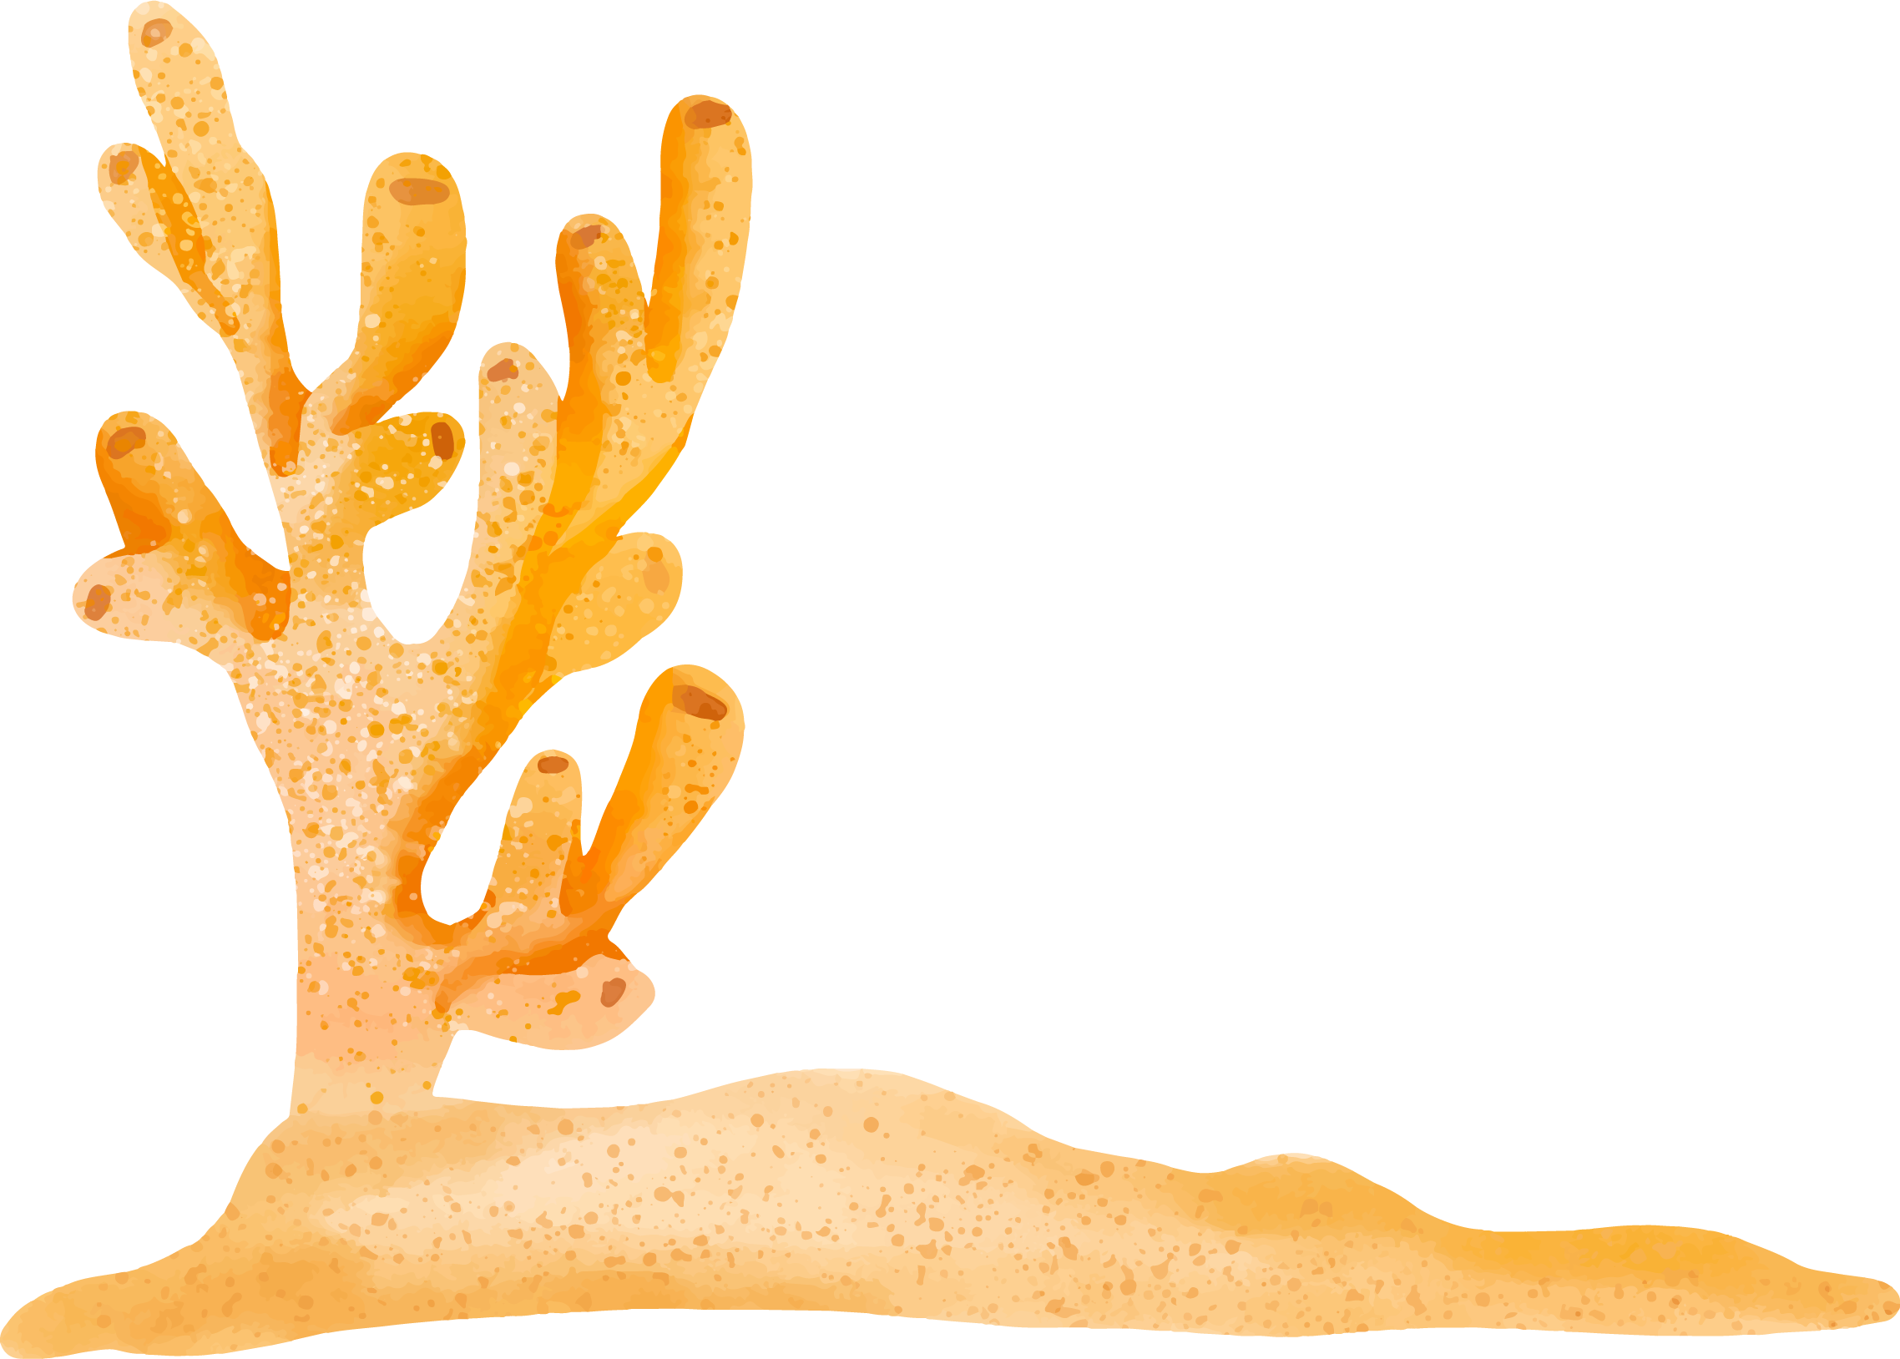


GOALS FOR RESEARCH
Uncover the effects of global climate change on the Australian Great Barrier Reef
Looking at historical trends in Sea Surface Temperature (SST) and the economic effects on tourism consumption near the Great Barrier Reef

Slide 4
QUESTIONS FOR RESEARCH
How has changing sea surface temperature(SST) affected the frequency and intensity of coral bleaching at the Great Barrier Reef since 2000?
Australian Tourism Consumption near the Great Barrier Reef affected by coral bleaching during bleaching events?

Slide 5


TERMINOLOGY

Slide 6
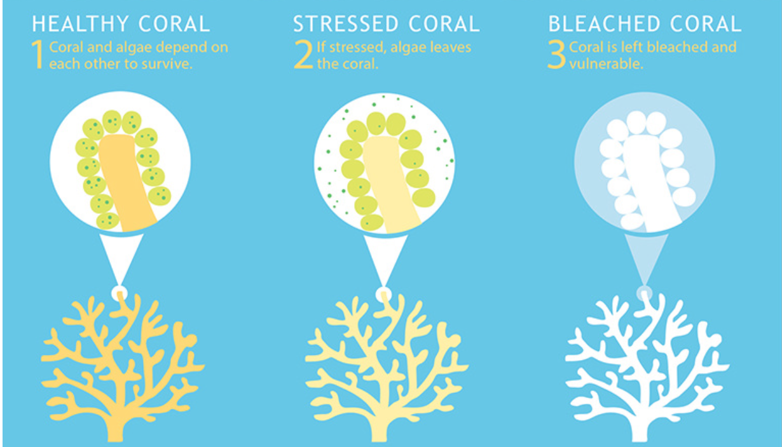
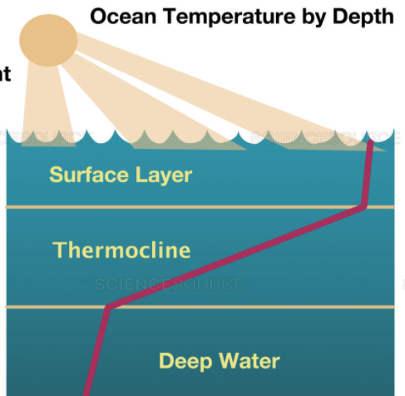
Coral Bleaching
Sea Surface Temperature(SST)
Corals have a symbiotic relationship
with algae called zooxanthellae.
When the algae is stressed, they
leave the coral’s tissue.
Without algae, the coral turns white
and more susceptible to disease.
Sea Surface Temperature is the average temperature at the uppermost layer of the ocean, only a few millimeters deep.
Sea surface temperature can be globally
monitored through satellite remote sensing.
Source: NOAA. What is eutrophication? National Ocean Service website, https://oceanservice.noaa.gov/facts/eutrophication.html, 10/05/17 Source: Sutton, Spencer. Ocean temperature by Depth. , https://www.sciencesource.com/CS.aspx?VP3=SearchResult&ITEMID=SS2591681#/SearchResult&ITEMID=SS2591681

Slide 7
Bleaching threshold
Bleaching Threshold
stressed coral
35
30
25
20
15
Maximum
Monthly Mean
(MMM)
Temperature
J F M A M J J A S O N D J F M A M J J A S O N D
Bleaching Threshold is 1° C more than max average month temperature
Corals start to become stressed when the SST is 1°C warmer than the maximum monthly mean temperature
When the SST is warmer than the bleaching threshold temperature, the corals will experience thermal stress.
This thermal stress is the main cause of mass coral bleaching
Source: Glynn, P. W. and L. D'Croz, 1990. Experimental evidence for high temperature stress as the cause of El Niño coincident coral mortality. Coral Reefs, 8, 181-191

Slide 8
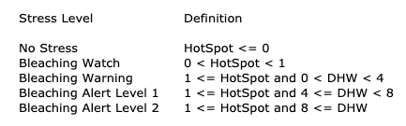
Degree Heating Week Values
DHW is way to measure not only how far the temperature is above the threshold, but how long it has stayed above that point
HotSpot (HS)
Sea Surface Temperature above the maximum mean monthly temperature
Degree Heat Week (DHW)
Thermal stress accumulated over a 12-week period. DHW is the the sum of HS value over a 12 week period ie. 3 months
SST@90th_HS
The daily SST value where the HotSpot value is equal to the 90th percentile HotSpot value for pixels contained in a Regional Virtual Station.
When the thermal stress reaches four degree C-weeks, you can expect to see significant coral bleaching,
especially in more sensitive species.
When thermal stress reaches eight degree C-weeks or higher, you would likely see widespread bleaching and mortality from the thermal stress.
Source: NOAA. Description for 5km Regional Virtual Stations, Time Series Data, and Graphs, https://coralreefwatch.noaa.gov/product/vs/description.php#ascii

Slide 9
DATA EXPLORATION
Dataset
Satellite remote sensing measurement data for Sea Surface Temperature (SST)
Source National Oceanic and Atmospheric Administration

Slide 10
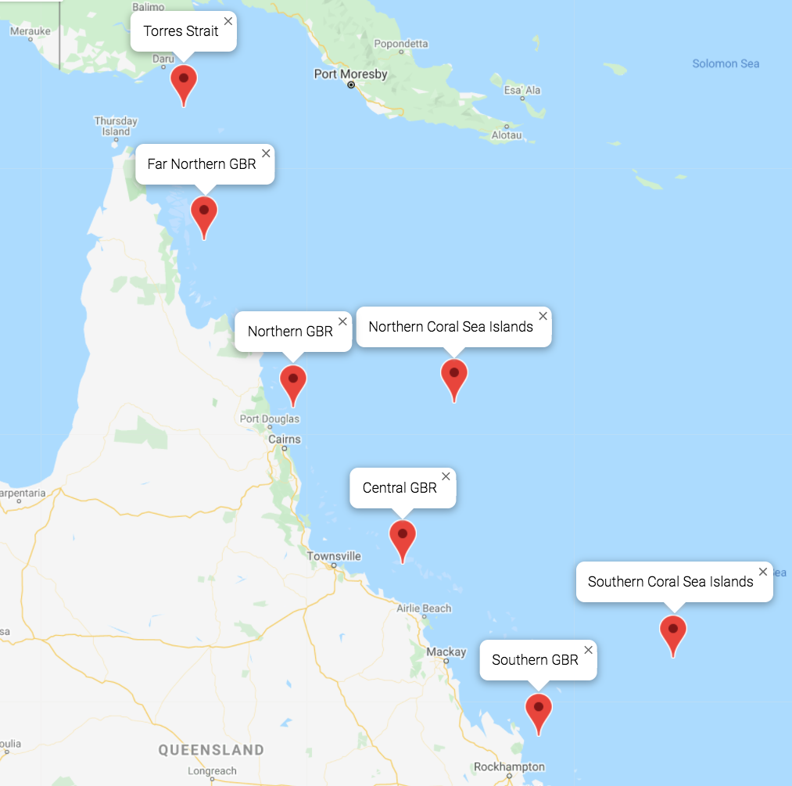
GREAT BARRIER REEF STATIONS
TROPICAL NORTH QUEENSLAND, AUSTRALIA
Plot using GBR station coordinates data and Google Maps API
Notes:
Chose this through
-National Oceanic and Atmospheric Administration(NOAA)
-Australian Government: Tourism Research Australia

Slide 11
DATA ANALYSIS
Northern Great Barrier Reef(GBR) Station
Central Great Barrier Reef(GBR) Station
Australian State Tourism Consumption

Slide 12
NORTHERN GREAT BARRIER REEF(GBR) STATION

Slide 13
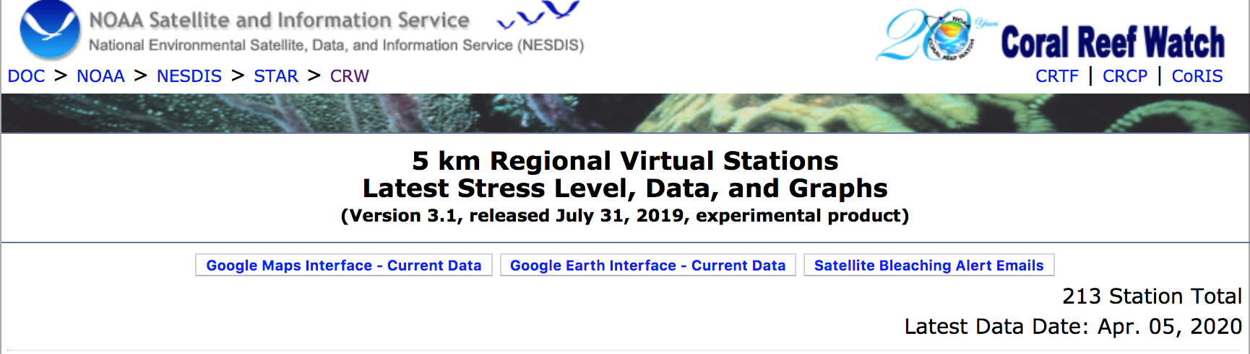
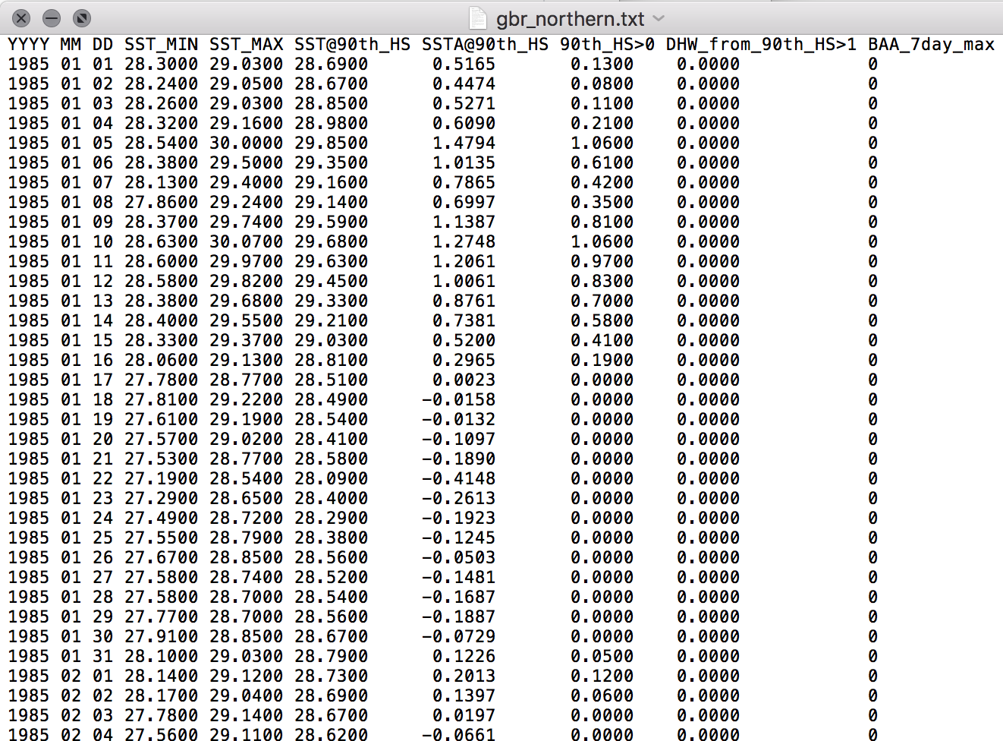
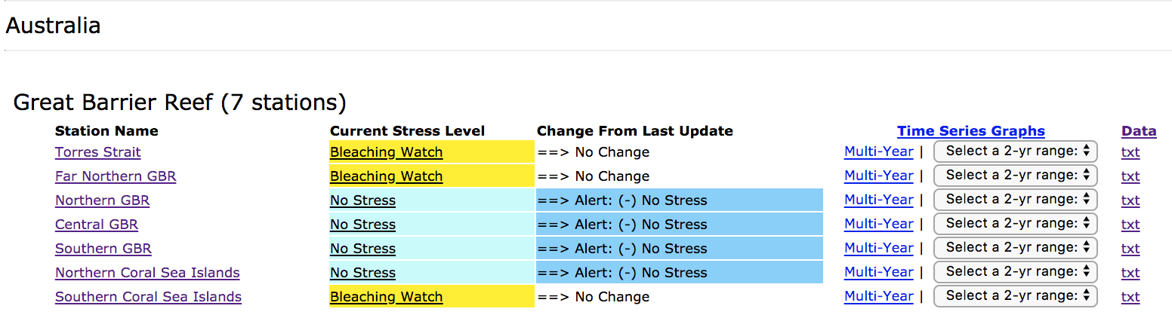
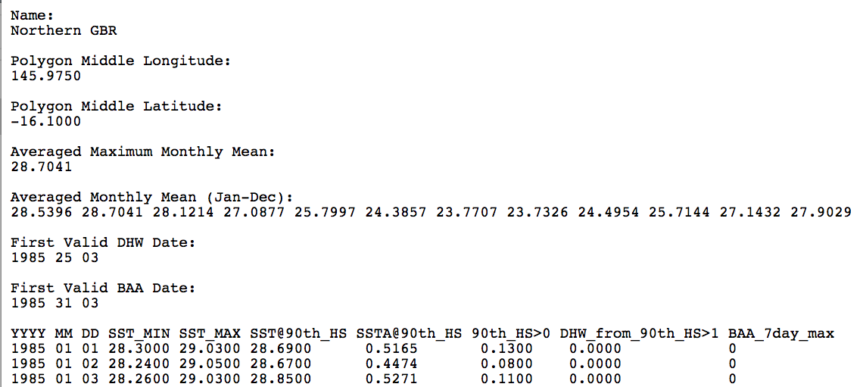
Data Cleanup process -Data download
To text file
Raw Data from NOAA(National Oceanic and Atmospheric Administration)

Slide 14
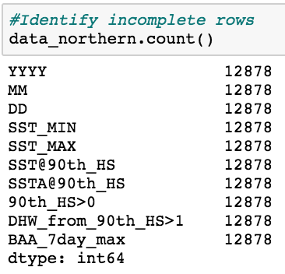
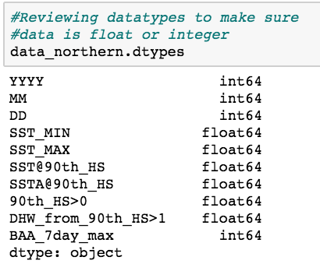
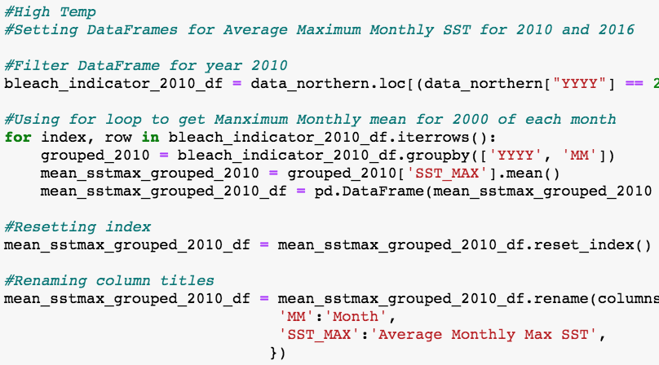
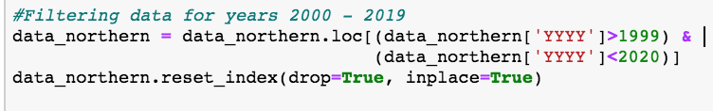
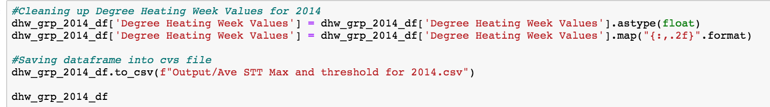
Data Cleanup process -Modifying datasets

Slide 15
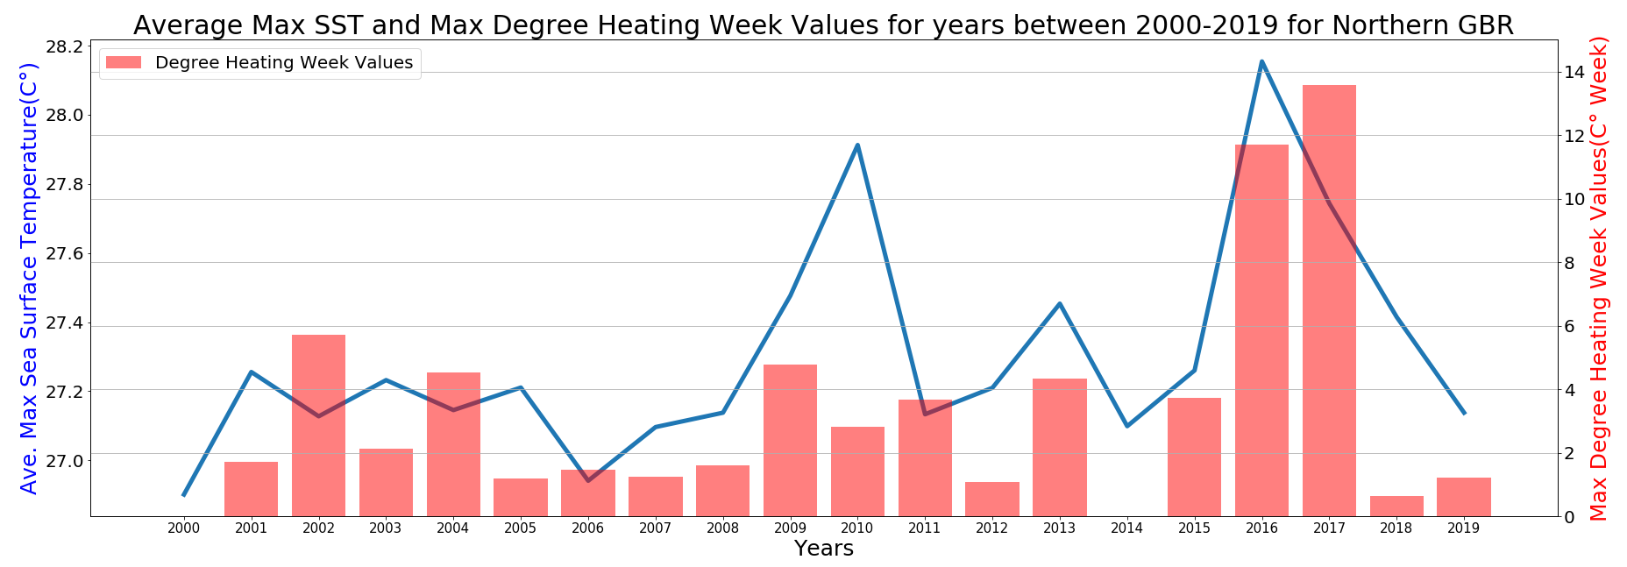
Northern GBR
Analysis
Looking at historic trends in Sea Surface Temperature (SST) and Degree Heating Weeks from 2000-2019 in the Northern Great Barrier Reef station. There were high points in the average SST in 2010, 2013, and 2016 -There were low points in the average SST in 2006, 2011, 2014, and 2019

Slide 16
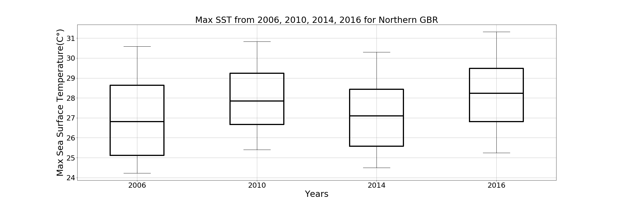
Northern GBR
Data distribution for 2006, 2010, 2014, 2016

Slide 17
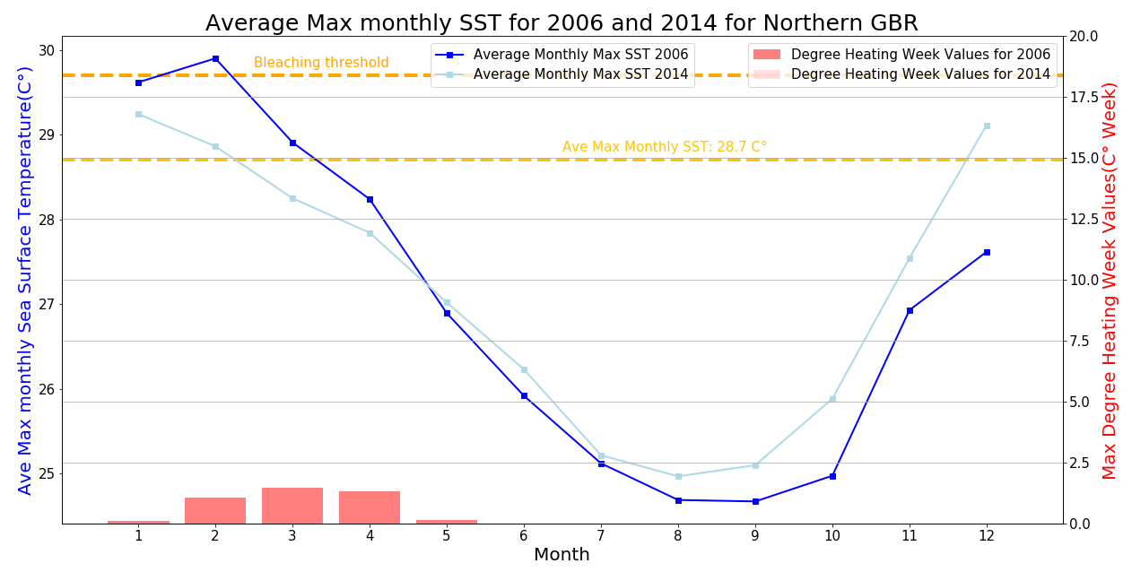
Northern GBR
Analysis:
This graph shows that in both 2006 and 2014, no degree heating week values were more than 4 or 8 indicating that sea surface temperatures did not increase more than the Average Maximum Monthly Mean of 28.7041 C° for very long.

Slide 18
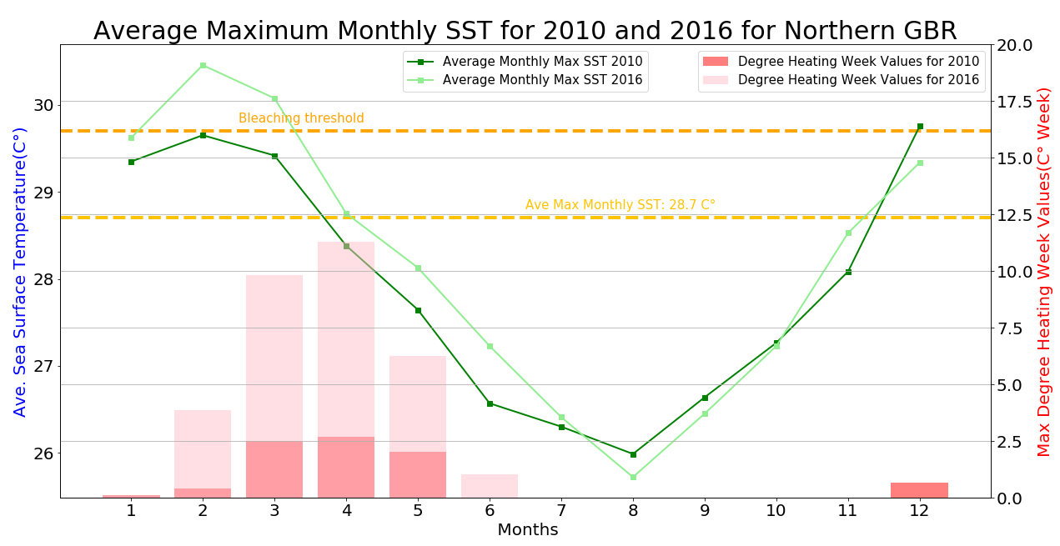
Northern GBR
Analysis:
This graph shows that in 2016 only, the degree heating week values reached over 8 indicating the sea surface temperatures did increase more than the Average Maximum Monthly Mean of 28.7041 C° for a long period of time. This would also mean that a widespread coral bleaching and marine mortality most likely occurred.

Slide 19
CENTRAL GREAT BARRIER REEF(GBR) STATION

Slide 20
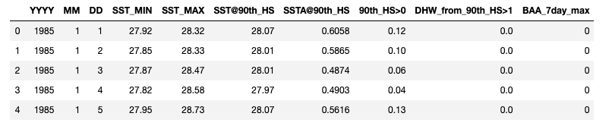
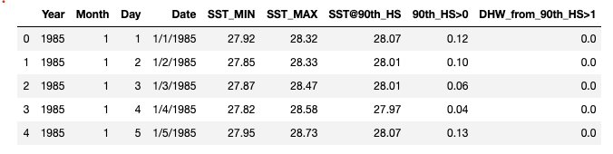
Data Cleanup process –Re organizing columns
Satellite remote sensing measurement data for Sea Surface Temperature (SST) for Central GBR
New Column
Source Link(NOAA website): https://coralreefwatch.noaa.gov/product/vs/data.php

Slide 21
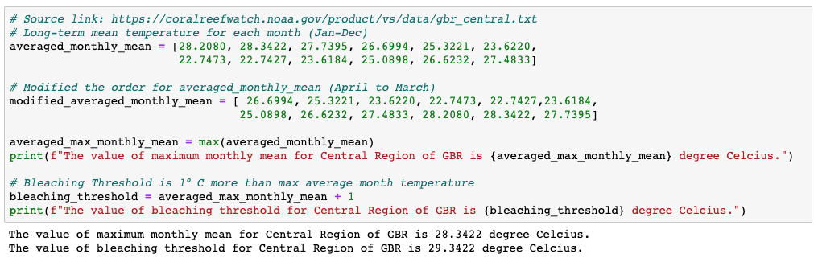
Max Monthly Mean: 28.34 °C
Bleaching Threshold: 29.34 °C

Slide 22
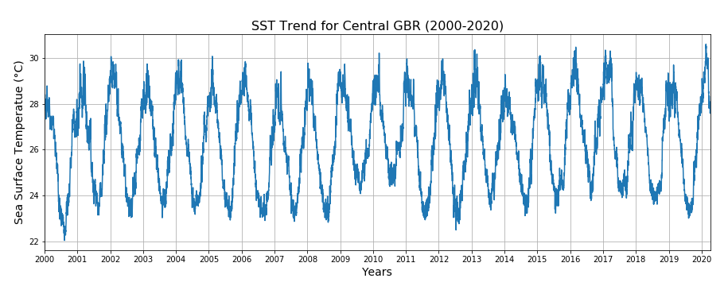
SST Trend for Central GBR (2000-2020)
Question:
What is the impact of climate change on the sea surface temperature in the Great Barrier Reef ?
Analysis
Daily SST temperature data for last 20 years
Noticeable increase in recent years

Slide 23

SST Trend for Central GBR (2000-2020)
Question:
What is the effect of increased SST on the coral species in the Central GBR region?
Code
# Grouping the five year data by year and month
# Calculating the monthly values for SST, HS and DHW
Analysis
Monthly SST data for last five years
Noticeable increase in 2016, 2017 and 2020
Plot
Monthly SST trend between 2015-2020 for Central GBR
Monthly HS and DHW trend between 2015-2020 for Central GBR

Slide 24
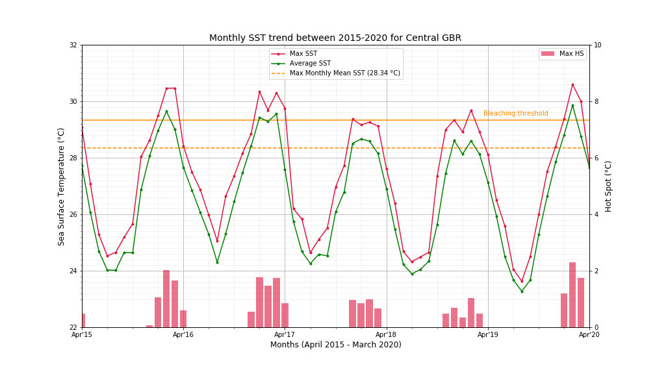

Slide 25
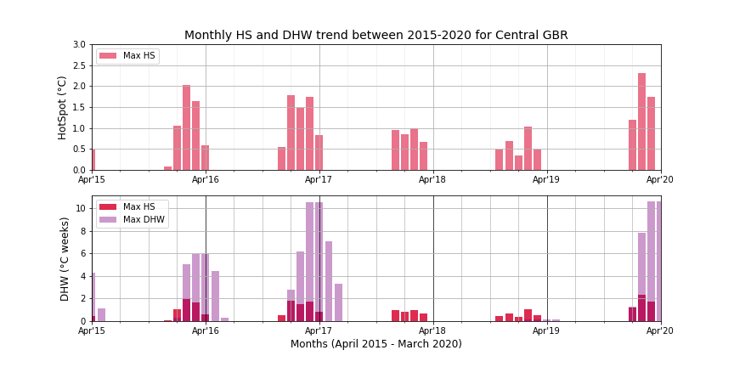

Slide 26
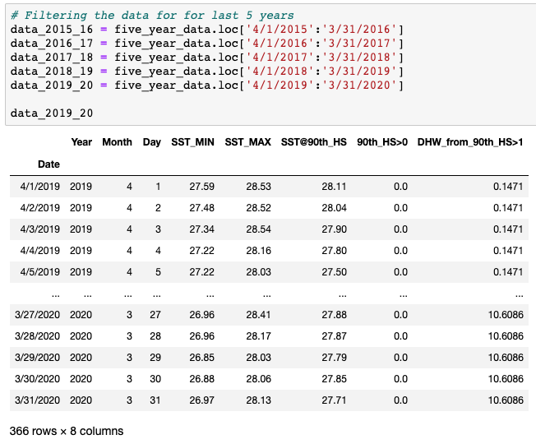
SST Trend for Central GBR (2000-2020)
Question:
How do each of last five year year compare with each other
Code
# Filter data year-wise
2015-16, 2016-17, 2017-18, 2018-19 and 2019-20
Summer: December to March

Slide 27
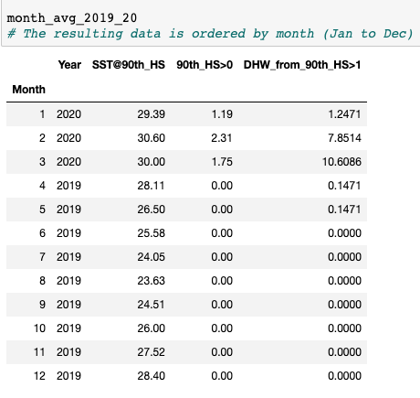
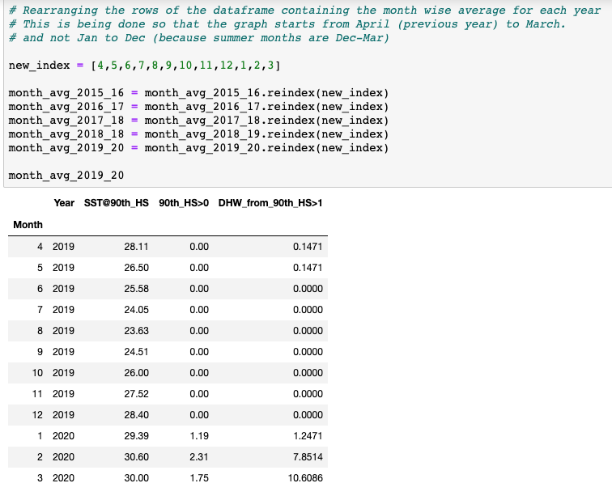
Reindexing to show April - March trend

Slide 28
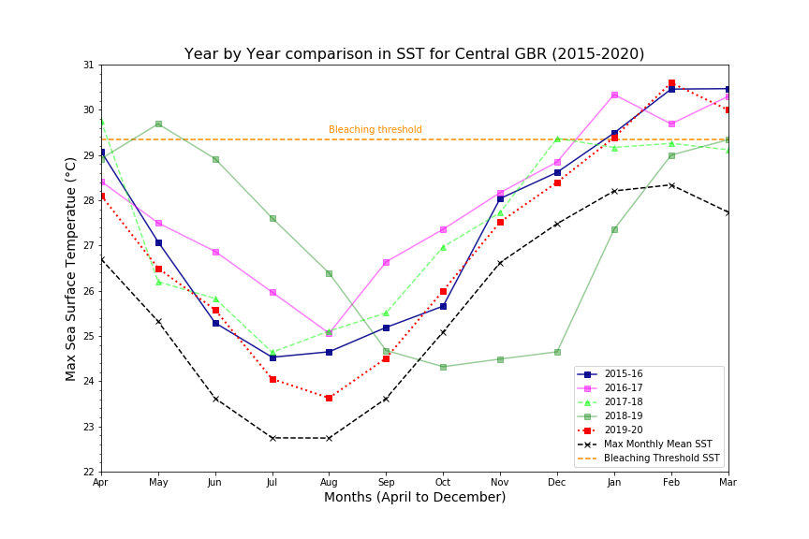

Slide 29
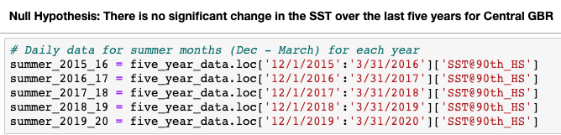
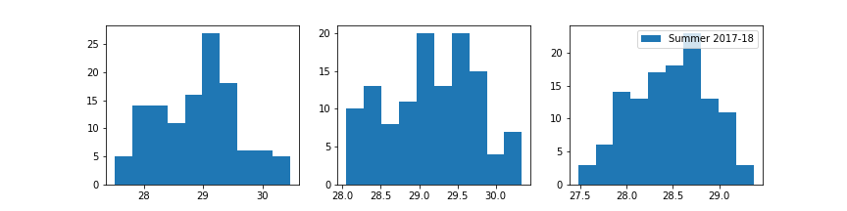
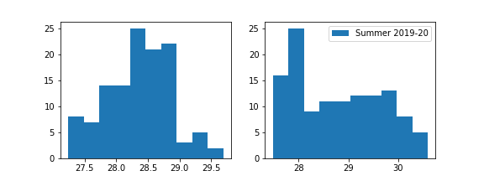
Question:
How do each of last five year year compare with each other if we consider only the summer months (December to March)?
Code
# Filter data for only summer months

Slide 30
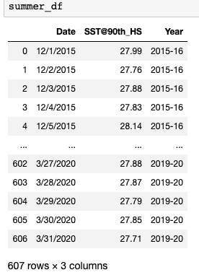
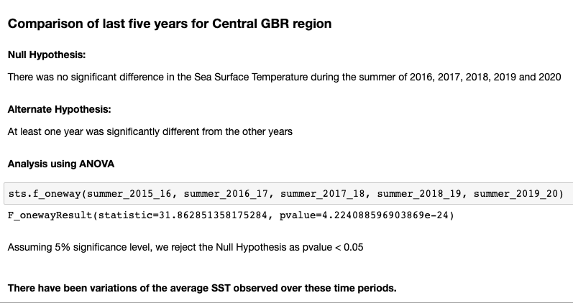
Combining data for summer months (last 5 years)

Slide 31
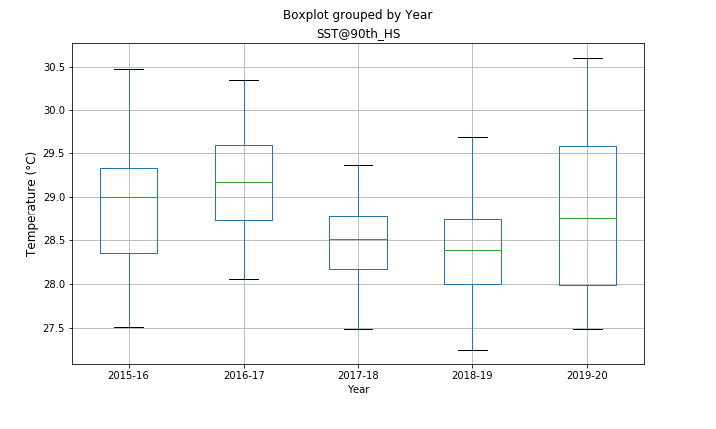

Slide 32
STATISTICAL
ANALYSIS

Slide 33
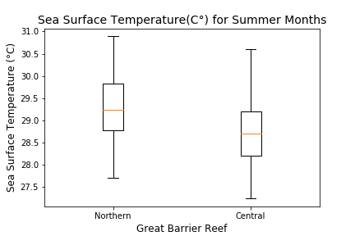
Comparison of Sea Surface Temperature Northern GBR vs Central GBR
Question:
Is the sea surface temperature different at different regions in the Great Barrier Reef?
Analysis
SST temperature data for last five years
Filtered data for only the Summer Months
Years: 2015 –2020
Months: December-March

Slide 34
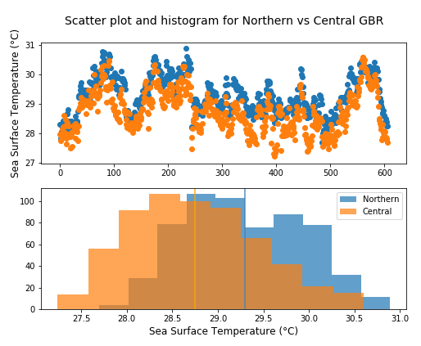
Comparison of Sea Surface Temperature cont.
Null Hypothesis:
There is no statistical difference between the Sea Surface Temperature for Northern GBR and Central GBR for the summer months
Alternate Hypothesis:
Sea Surface Temperature at Northern GBR is different from Central GBR
Using Independent T-Test
statistic=14.29 , pvalue=6.52e-43
Mean SST Northern: 29.3°C, Mean SST Central: 28.75°C
Assuming 5% significance level, we reject the Null Hypothesis as pvalue < 0.05

Slide 35
AUSTRALIAN STATE
TOURISM CONSUMPTION

Slide 36
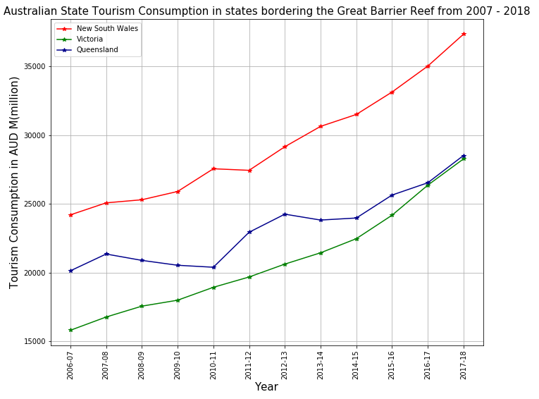
Australian State Tourism Consumption

Slide 37
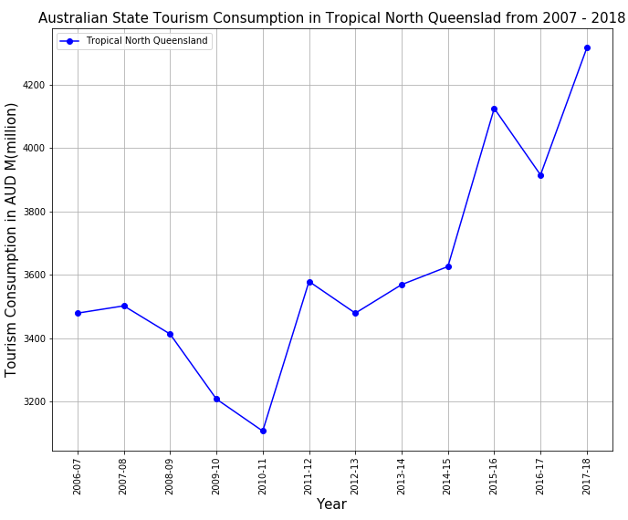
Tropical North Queensland Tourism Consumption

Slide 38
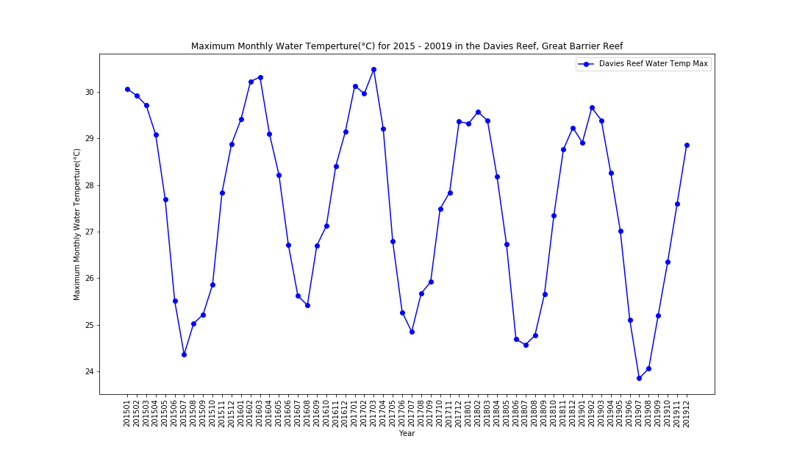

Slide 39
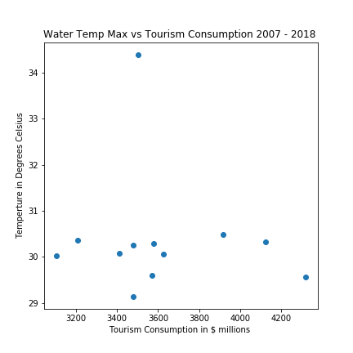

Slide 40
TEAM REFLECTION
AND
FUTURE DATA EXPLORATION

Slide 41
Lessons Learned and Future exploration
Insights
Daily satellite tracking of sea surface temperatures
Problems:
Trying to make our own functions to minimize code repetition
Difficulties:
Formatting of graphs
Future exploration:
Coral reef area cover, different GBR stations, different Australian states revenue and from monthly or daily reports instead of annual reports

Slide 42
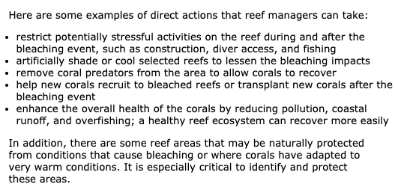
Protecting the Reef

Slide 43
SOURCES
Google API
Northern and Central Great Barrier Reef Station raw data
Australia state Tourism Consumption raw data
Bleaching Threshold
Coral Heat Stress
Water Temperature at Davies Reef

Slide 44
QUESTIONS?

